Slide 1

ACCURATE FACE MASK DETECTION SYSTEM USING DEEP LEARNING AND YOLOv8
SUPERVISOR
Ms. SUBHA K J
Assistant Professor / ECE
TEAM MEMBERS
T.VIKAS REDDY (VTU20401)
P.VANDANA (VTU20369)
L.SRIRAMA KOTESWARARAO (VTU21249)

Slide 2
CONTENT
Abstract
Objective
Introduction
Literature Survey
Block diagram
Software used
Methodology
Result and Analysis
References

Slide 3
ABSTRACT
In response to the global pandemic the need for the accurate face mask detection system has become high to ensure public safety.
The total number of image datasets are of 3833 images which are classified into 1915 masked dataset and 1918 unmasked dataset.
This project proposes a real time accurate face mask detection system where we use MobileNet to train the data and YOLOv8 for detecting.
System integrates computer vision techniques with deep learning to detect faces in real time video streams and classify whether individuals are wearing masks or not wearing masks.

Slide 4
OBJECTIVE
The objective of this project is to develop and implement a real-time face mask detection system using YOLOv8, aiming to achieve high accuracy in identifying individuals wearing masks in various environmental conditions.
By leveraging deep learning techniques and annotated datasets, the system will be optimized for speed and efficiency, with the goal of supporting public health initiatives and enhancing security protocols during the COVID-19 pandemic and beyond.

Slide 5
INTRODUCTION
Face mask identification is a process of detecting whether a person is wearing a face mask and, if so, how it is being worn . This technology is part of the broader category of object detection in computer vision, where the object of interest is a face with or without a mask.
MobileNet is a class of Convolutional neural network(CNN) that was open sourced by google and therefore provides an excellent starting point for training classifiers that are insanely small and insanely fast.
YOLOv8 is a state of the art deep learning model designed for real time object detection in computer vision apllications. With its advanced architecture and cutting edge alogorthims.YOLOv8 has revolutionized the field of object detection and efficient detection of objects in real time scenarios.

Slide 6
LITERATURE SURVEY
S No | Title | Author Details, Published year | Algorithm Used | Inference
1. | Face mask detection using semantic segmentation | Toshanlal Meenapal,Balakrishanan,2019 | VGG16,Fully Convolutional network | Recognize the face by segmentation and detection using Models. The Proposed network can detect non frontal faces and multiple faces from a single image.
2. | Covid-19 facemask detection | Ms.R.Suganthalakshmi, A.Hafeeza,2020 | Computer vision | The system comprises Mobile Net as the spine which can be very well utilized for high and low calculation situations.in order to extract more robust features, learning is used to gain weights from a similar task face detection ,which is trained on large datasets.
3. | Face mask detection using CNN | Adithya k,Jismi Babu,2021 | R-CNN,ANN | A Review on Face Mask Detection using Convolutional Neural Network
4. | Face mask detection for preventing Covid-19 | Susanto,Febri Alwan Putra,2021 | YOLOv4 | This work developed the face mask detection by using YOLO V4 algorithm. The algorithm is able to detect and distinguish a non-wearing and a wearing-mask precisely with any condition of the surrounding environment

Slide 7
LITERATURE SURVEY
S No | Title | Author Details, Published year | Algorithm Used | Inference
5. | Face Mask Detection Using YOLOv3 and YOLOv4 | Saeed Khorram, Chen-Ping Yu, Kuang-Yu Cheng,2021 | YOLOv3, YOLOv4 | The Proposed network can detect non frontal faces and multiple faces from a single image of the given data set.
6. | Real-time Face Mask Detection in Public Transportation | John Smith, Emily Johnson, Michael Brown,2022 | YOLOv5, CNN | Utilizes YOLOv5 for real-time face mask detection, ensuring effective monitoring in public transportation environments.
7. | Face Mask Detection Using Deep Learning and Transfer Learning Techniques | Maria Gonzalez, David Lee, Ananya Sharma,2023 | Transfer Learning with MobileNetV2 | leverages transfer learning with MobileNetV2 to enhance face mask detection accuracy while maintaining low computational requirements.
8. | Enhancing Face Mask Detection Accuracy with Ensemble Learning | Ahmed Khan, Lisa Roberts, Steven Wan,2023 | Ensemble Learning with CNN and RNN | Achieves robust performance by effectively handling variations in mask types, face angles, and lighting conditions.

Slide 8
BLOCK DIAGRAM
Data collection (Face mask detection)
Testing
Data Pre processing
Split the dataset into training and testing
Training
Detect faces using YOLOv8
Model trained using
MobileNet
OUTPUT
MASK
NO MASK

Slide 9
Methodology
Data Acquisition and Preparation:
Load the images: Begin by loading the images that will be used for training and testing the face mask detection model. The total images loaded are 3883.
Label images into its class: Assign labels to each image indicating whether it contains a person wearing a mask ("MASK") or not ("NO MASK").
Split the dataset into training and testing: Divide the labeled image dataset into two subsets: one for training the model (typically a larger portion) and another for evaluating its performance (testing set).
2. Face Detection and Preprocessing:
Detect faces using face detector from OpenCV: Employ a face detection algorithm to identify faces within the images. OpenCV is a popular computer vision library with various face detection implementations.
Preprocess the image: Perform image preprocessing steps on the detected face regions to improve the model's performance. These steps might include resizing, cropping, normalization, and enhancing contrast.

Slide 10
Methodology
3. Model Training:
Model trained using MobileNet: Train a dataset using the labelled training data. 20% of the data 777 images are used for training.
4.Model Testing:
Load the saved model: Once the model training is complete, Evaluate the model YOLOv8.
Pass as input to facemask detection model: Feed the preprocessed images containing detected faces as input to the trained YoloV8 model.
80% of the data which means 3106 images are used for testing.
5. Output:
The model will output predictions for each image, classifying it as either "MASK" or "NO MASK".

Slide 11
ALGORITHM used
Convolutional Neural Network (CNN):
A Convolutional Neural Network (CNN) serves as the underlying algorithm. CNNs are particularly well-suited for image recognition tasks, making them a natural choice for this facial mask detection application.
The CNN architecture is designed to automatically learn hierarchical representations of features from facial images, enabling the model to discern patterns associated with the presence or absence of face masks.
The specific design of the CNN architecture, including the number and configuration of convolutional layers, pooling layers, and fully connected layers, is tailored to optimize the model's ability to capture intricate features relevant to mask recognition.
Additionally, transfer learning is explored, leveraging pre-trained CNN models such as ResNet or MobileNet.

Slide 12
Software Used
Software:
1.Google Collab: Google Colab, short for Colaboratory, is a free cloud-based platform developed by Google that allows users to write and execute Python code in Jupyter notebooks. It provides a powerful environment with access to free GPU and TPU resources, making it ideal for machine learning and data analysis tasks. Colab integrates seamlessly with Google Drive, enabling easy storage and sharing of notebooks. It supports various popular libraries and frameworks, such as TensorFlow and PyTorch, facilitating advanced computations and model training.
2.Visual studio: Visual Studio is a comprehensive integrated development environment (IDE) developed by Microsoft, used for building, debugging, and deploying applications across multiple platforms. It supports a wide range of programming languages, including C#, C++, Python, and JavaScript, offering robust tools for code editing, debugging, and version control. Visual Studio provides advanced features like IntelliSense code completion, integrated testing frameworks, and a powerful debugger.

Slide 13
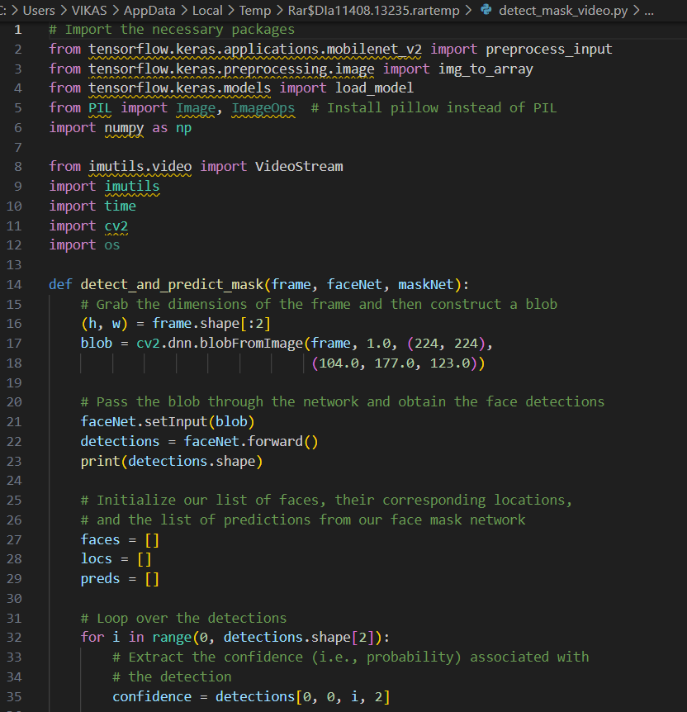
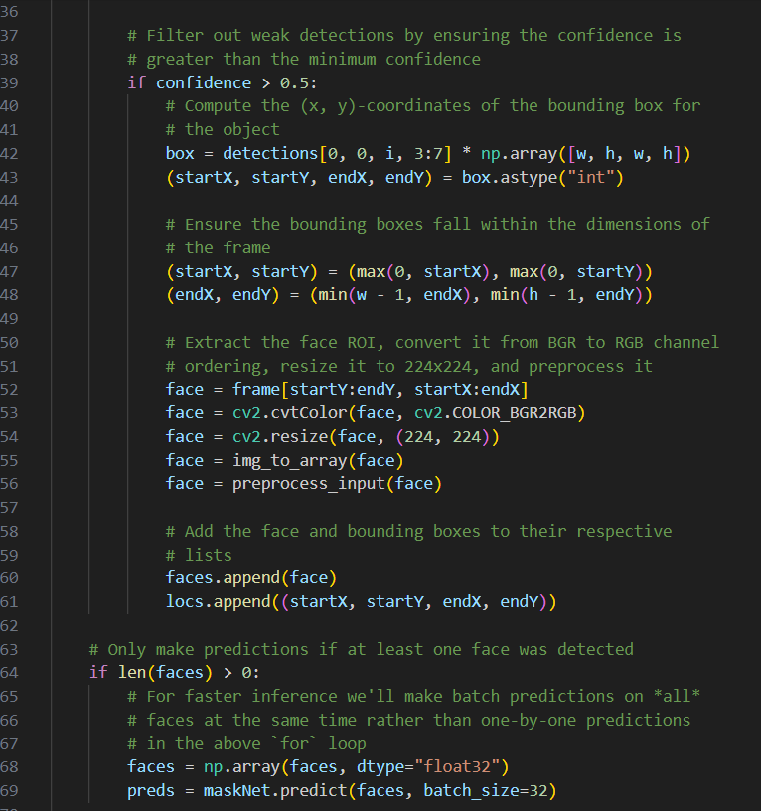
Source code

Slide 14
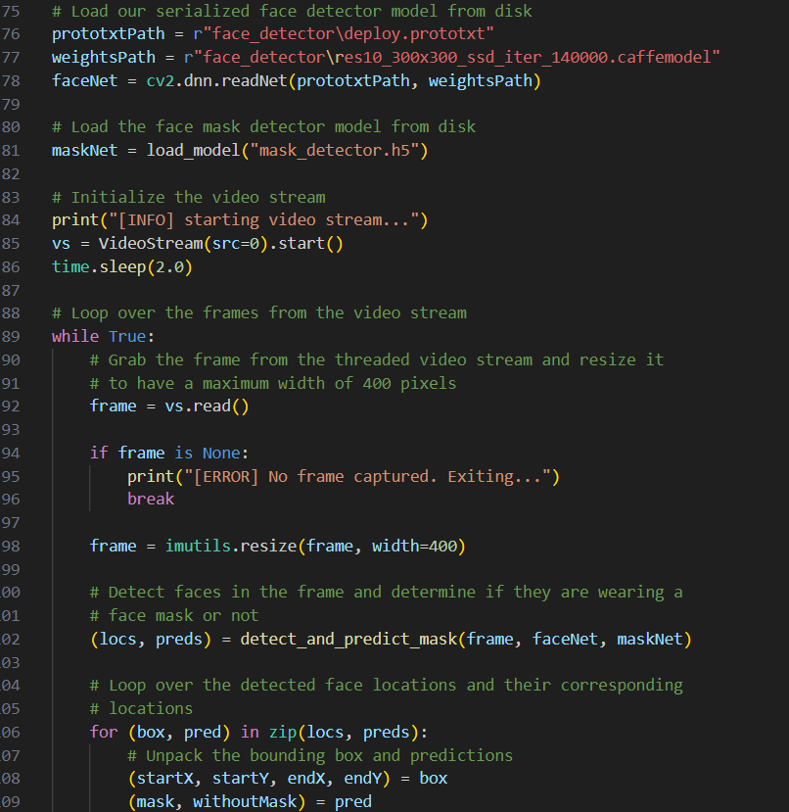
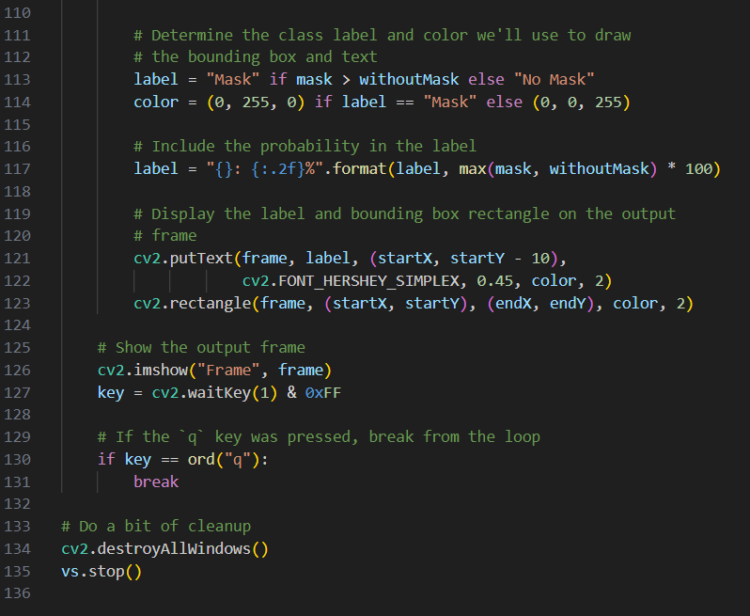
Source code

Slide 15
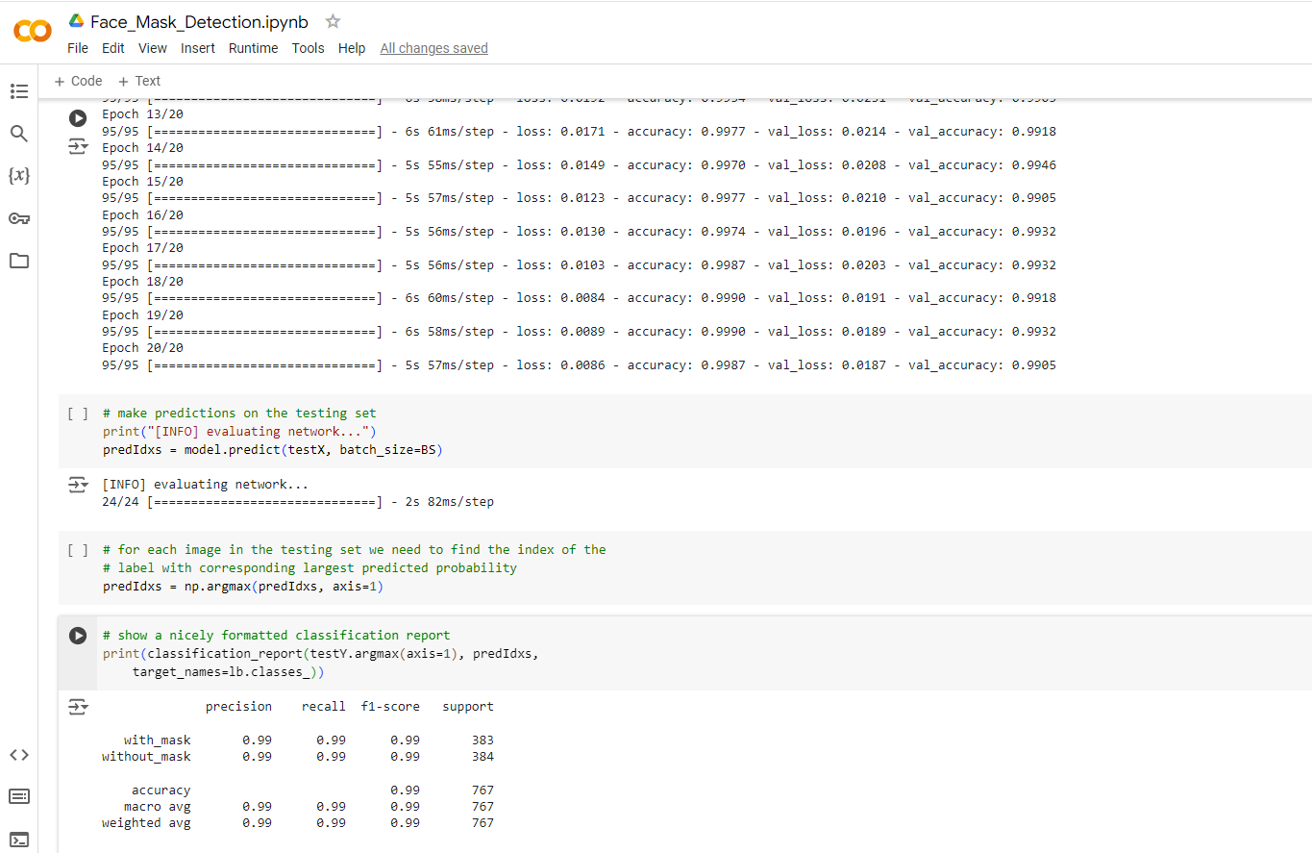
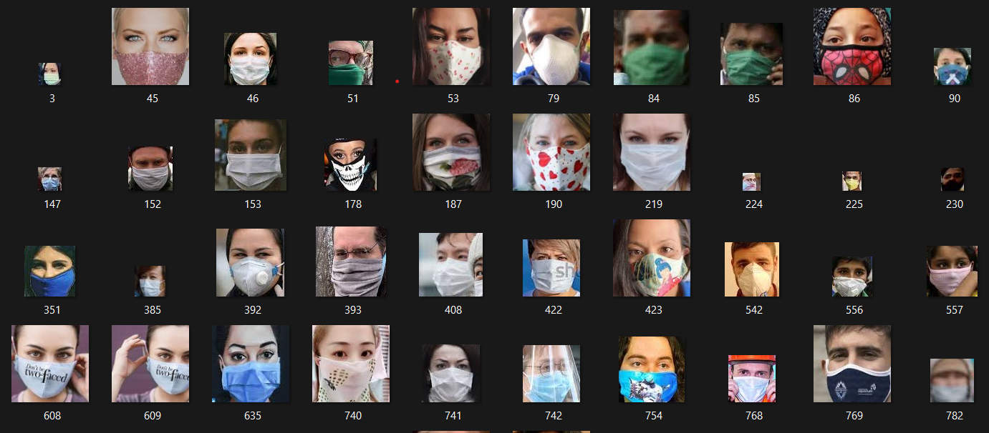
RESULT AND ANALYSIS

Slide 16
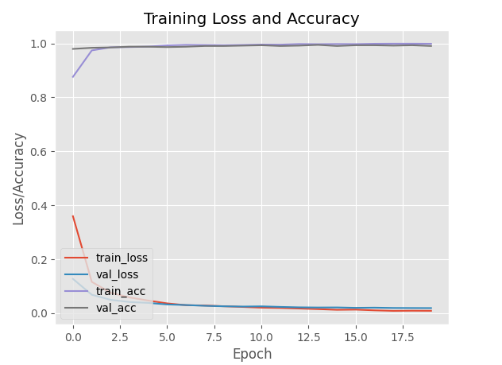
RESULT AND ANALYSIS

Slide 17
RESULT AND ANALYSIS

Slide 18
conclusion
In conclusion, the face mask recognition model emerges as a pivotal technological solution in addressing the pressing challenges of public health and safety. Through rigorous unit testing and careful consideration of various factors such as image processing, face detection, and real-time processing capabilities, the model demonstrates its potential to revolutionize the way we navigate our daily lives.
This digital innovation not only challenges the existing status quo but offers a proactive approach to mitigating the spread of infectious diseases. By seamlessly integrating into diverse industries and ensuring compliance with face mask mandates, the model stands as a beacon of efficiency and effectiveness.
As we move forward, the face mask recognition model embodies the convergence of health and technology, providing a scalable and adaptable solution that holds promise for a safer, healthier future for communities worldwide. Its role in automating and enhancing mask-wearing protocols reflects a commitment to leveraging cutting-edge technology for the collective well-being, ushering in an era where digital solutions play a central role in safeguarding lives.

Slide 19
References
1] Liu, Z., Deng, W., Hu, J. (2022). Deep learning for face recognition with mask A survey. Pattern Recognition Letters, 192, 116871.
[2] Gong, S., Li, L., Wang, W. (2022). Mask-aware face recognition with patch-based convolutional neural networks. IEEE Transactions on Image Processing,31(7), 3024-3035.
[3] Guo, Y., Lei, Y., Jin, L. (2020). A lightweight deep learning model for masked face recognition. IEEE Access, 8, 102424-102433.
[4] Maszczyk, T., He, X. (2022). R2F: Residual regression for face recognition with masks. arXiv preprint arXiv:2202.07444.
[5] Zhao, X., Zhao, Z., He, R. (2023). Masked face recognition with attention-based spatial-temporal feature fusion. IEEE Transactions on Circuits and Systems for Video Technology, 33(1), 144-157.

Slide 20
References
[6] Johansson MA, Quandelacy TM, Kada S, Prasad PV, Steele M, Brooks JT, et al. SARS-CoV-2 transmission from people without COVID-19 symptoms. JAMA Netw Open. (2021) 4:e2035057. doi10.1001/jamanetworkopen.2020.35057
[7] Kaur G, Sinha R, Tiwari PK, Yadav SK, Pandey P, Raj R, et al. Face mask recognition system using CNN model. Neurosci Inform. (2021) 2:100035. doi: 10.1016/j.neuri.2021.100035 CrossRef Full Text | Google Scholar
[8] Fan X, Jiang M, Yan H. A deep learning based light-weight face mask detector with residual context attention and Gaussian heatmap to fight against COVID-19. IEEE Access. (2021) 9:96964–74. doi: 10.1109/ACCESS.2021.3095191
[9] Sifre L, Stéphane M. Rigid-Motion Scattering for Image Classification Author (Ph. D. Thesis). Stéphane M, editor. Ecole Polytechnique
[10] Le DN, Parvathy VS, Gupta D, Khanna A, Rodrigues JJ, Shankar K, et al. IoT enabled depthwise separable convolution neural network with deep support vector machine for COVID-19 diagnosis and classification. Inter J Mac Learn Cybernet. (2021) 12:1–14. doi: 10.1007/s13042-020-01248-7

Slide 21
Thank you

